Slide 1
Sagar – Portfolio Management

Slide 2
Projects
GDFL Data Upload
Back Testing
Strategy Management
Data Harvesting
Optimization
User Role Management
Client Management

Slide 3
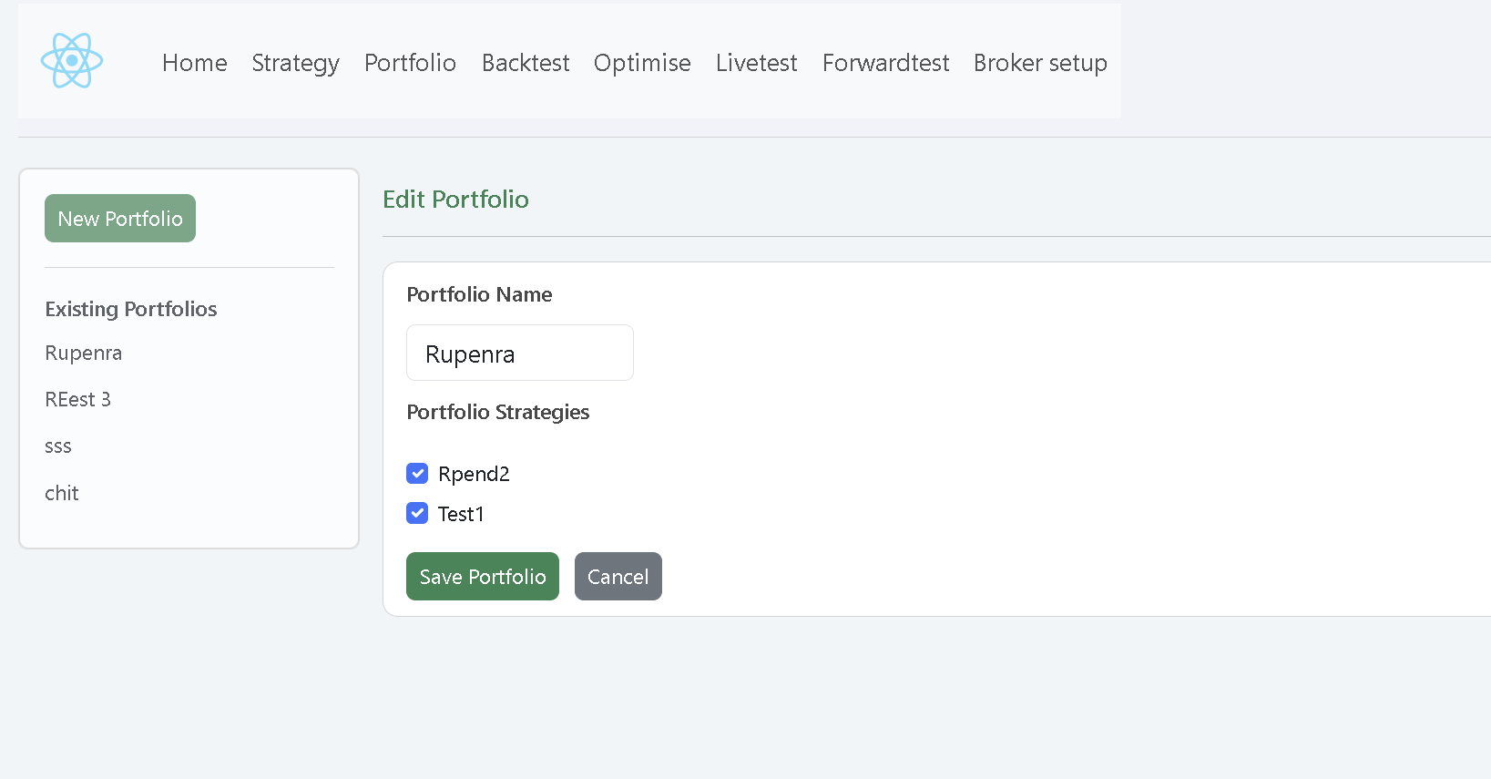
GDFL Data Upload Work Status UI Screen – Completed Backend – Completed

Slide 4
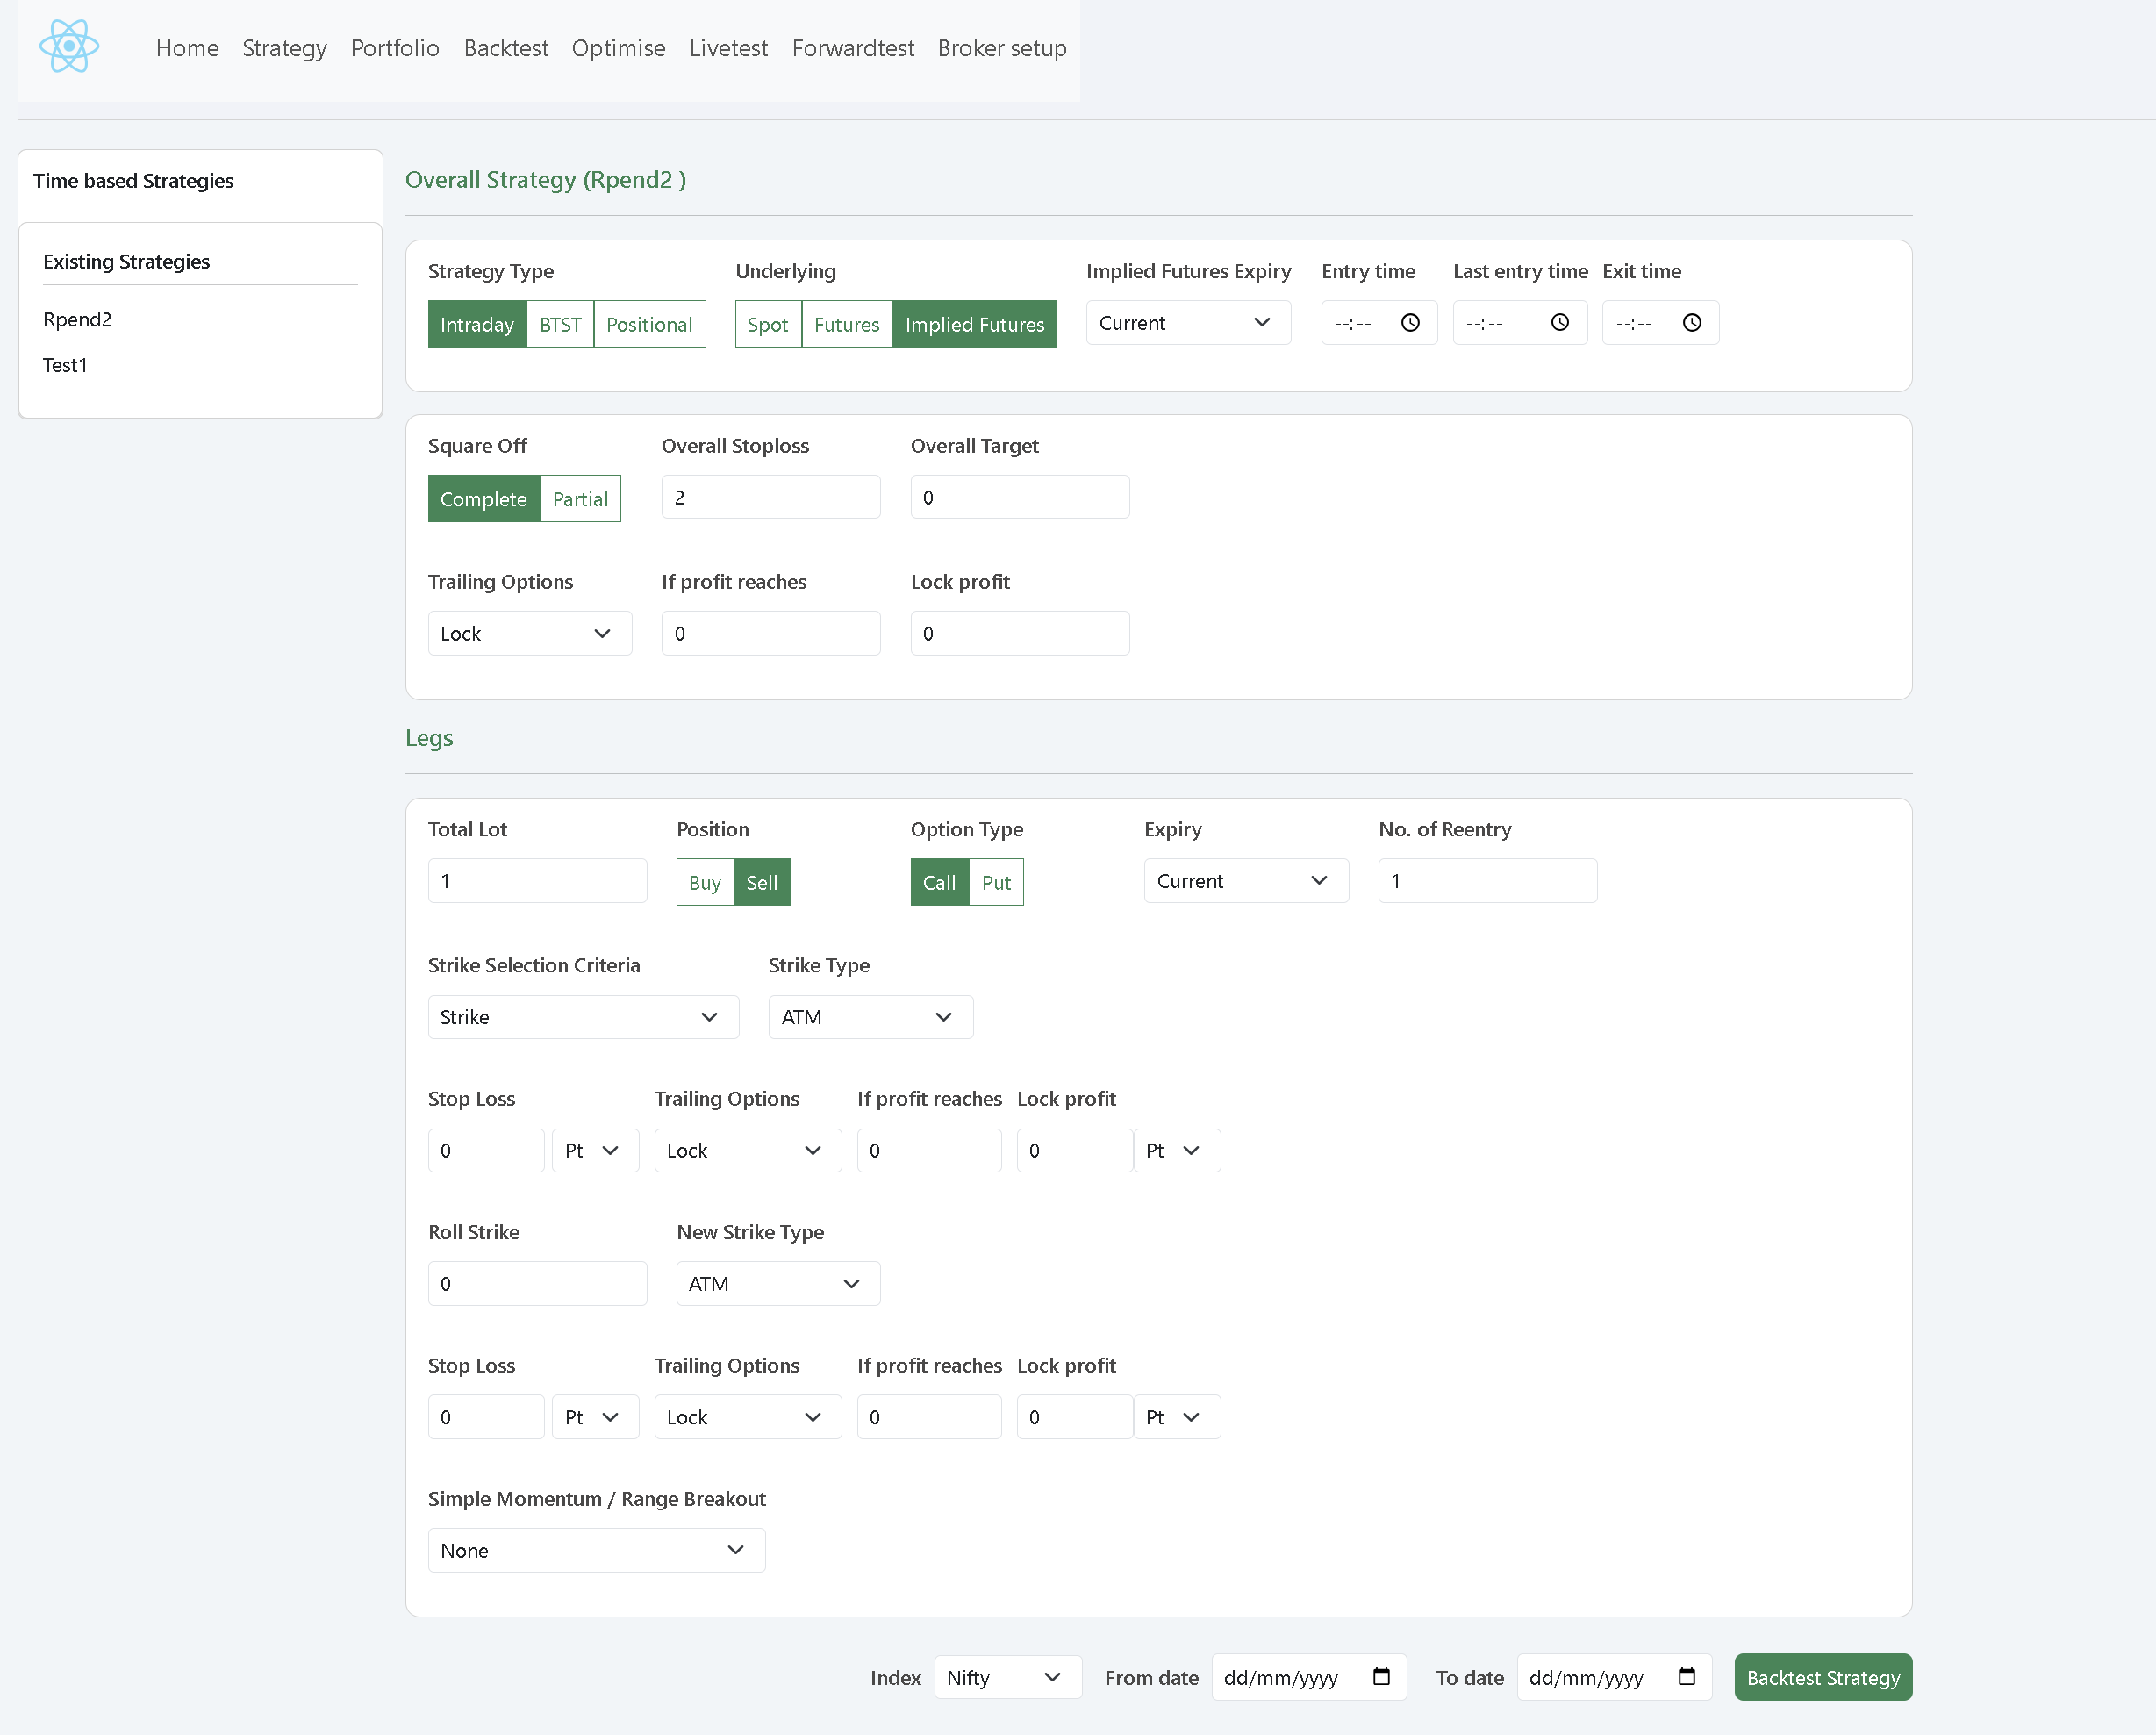
Back Testing Work Status UI Screen – Completed Backend – Completed

Slide 5
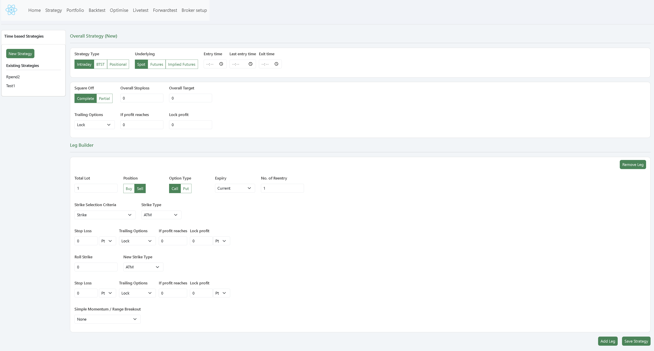
Strategy Management (Strategy Creation screen) Work Status UI Screen – Completed Backend – Completed

Slide 6
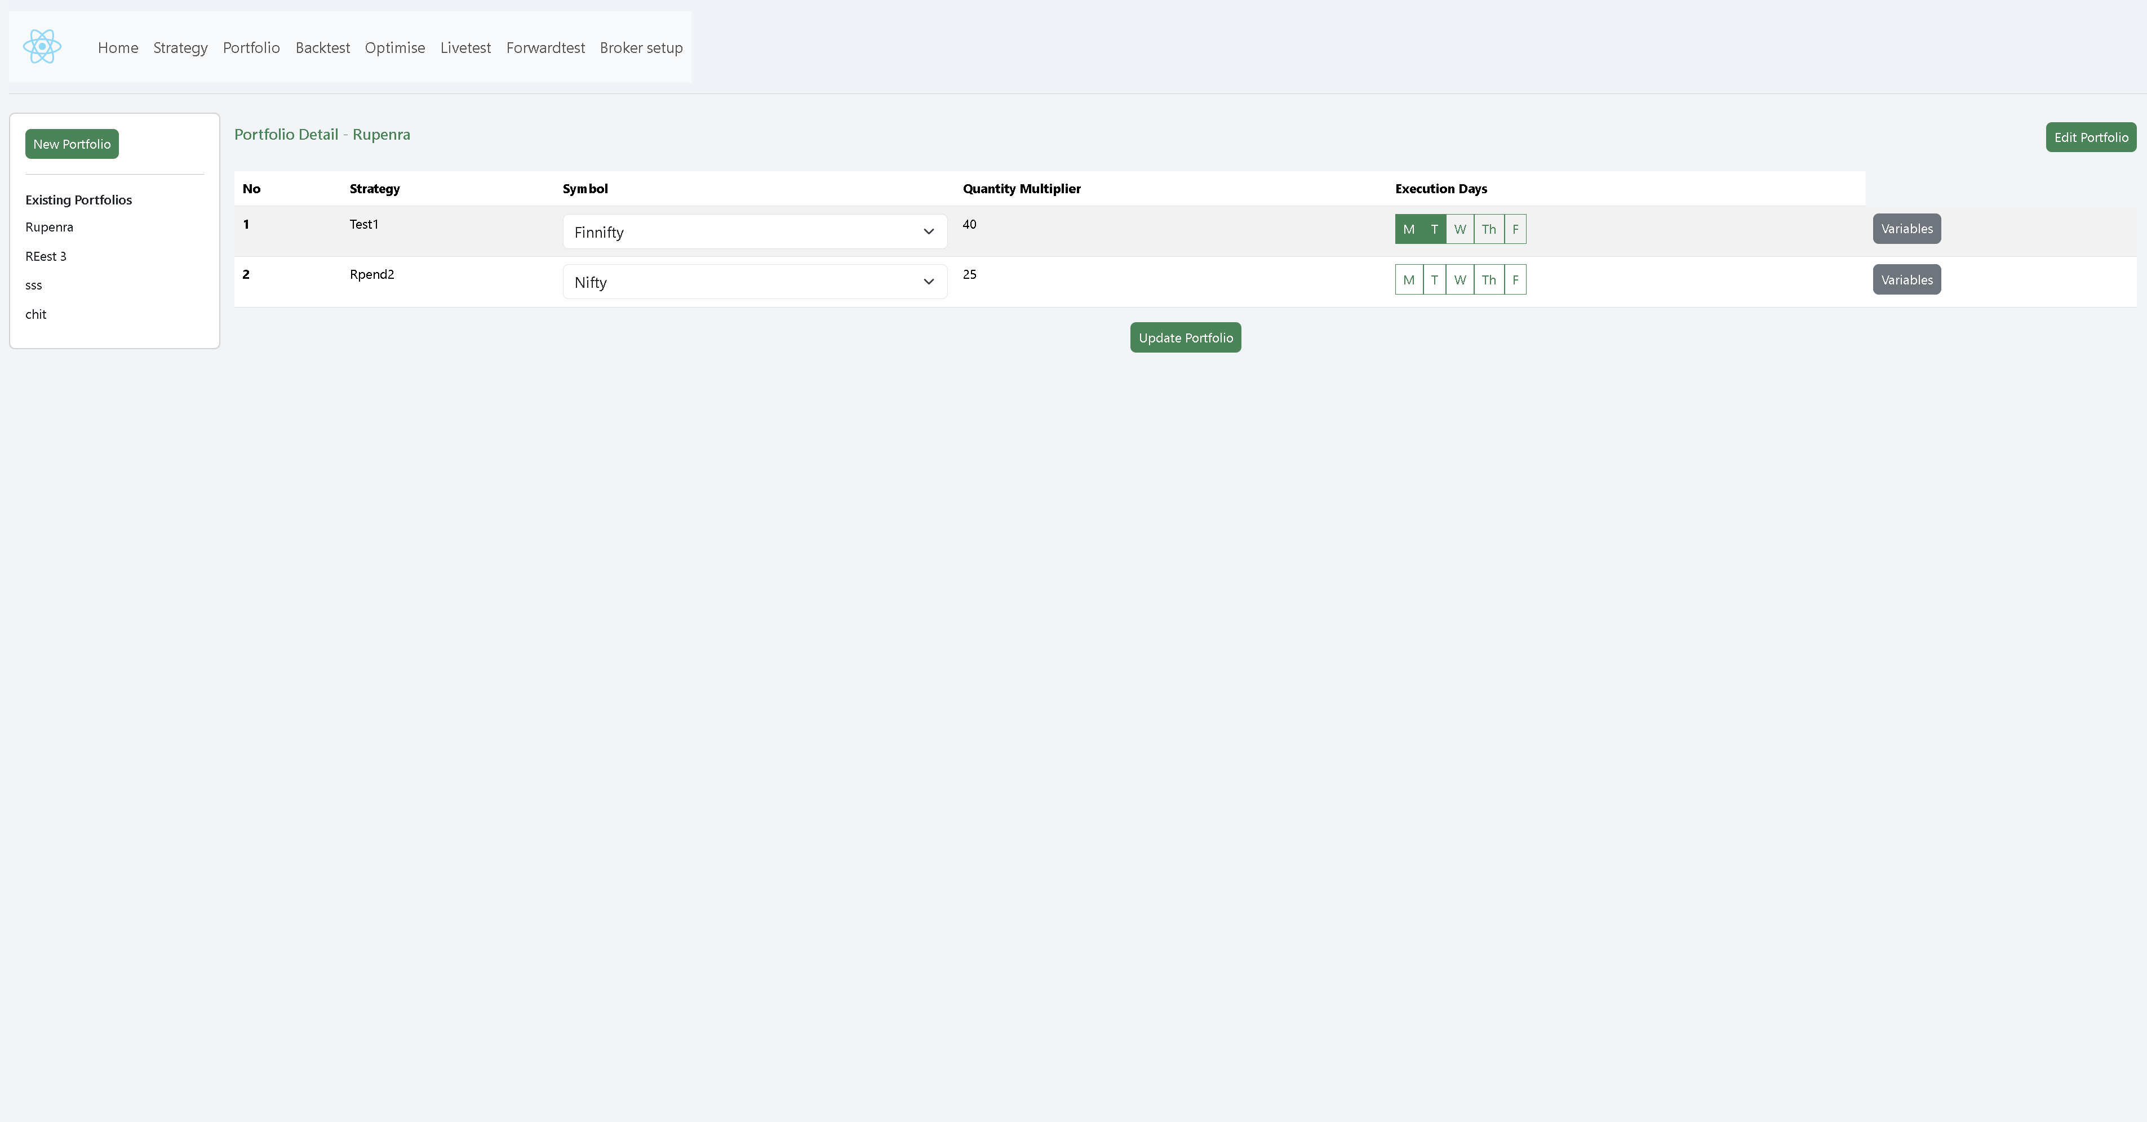
Strategy Management (Portfolio Creation screen) Work Status UI Screen – Completed Backend – Completed

Slide 7
Strategy Management (Portfolio Adding Strategy screen) Work Status UI Screen – Completed Backend – Completed

Slide 8

Data Harvesting Work Status Backend – Completed Achievement 60 % Data we are able to capture

Slide 9
Optimization Work Status UI – Work in Progress Backend – Completed

Slide 10
User Role Management Work Status UI – Work in Progress Backend – Work in Progress

Slide 11
Client Management Work Status UI – Work in Progress Backend – Work in Progress

